Slide 1
Disease Normalization with Graph Embeddings
Proceedings of SAI Intelligent Systems Conference, Aug 2020
D.Pujary et el. , University of Amsterdam

Slide 2
Previous Problems
KB entity representations does not use semantic information between them.
The idea is to use the hierarchical graph structure of Ontology to get better entity representations.
This is done by using the KB graph to get graph embeddings.

Slide 3
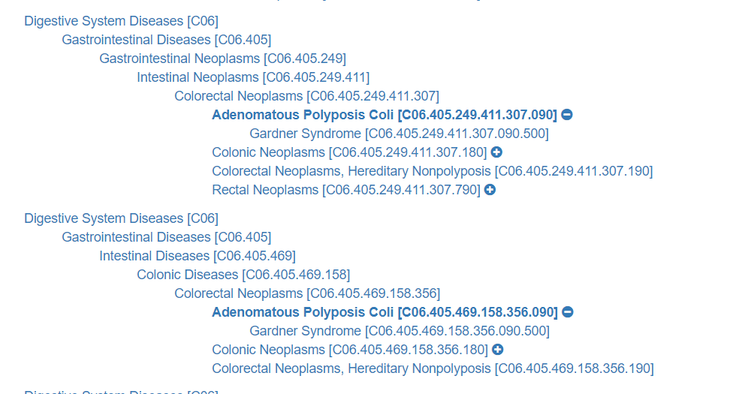
MESH Ontology
MESH KB has concepts in a hierarchical manner like this :

Slide 4
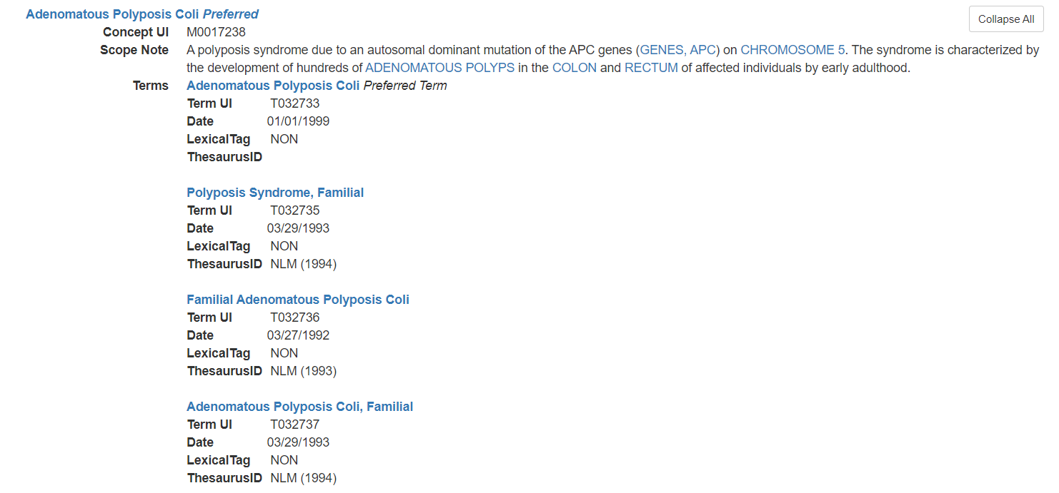
MESH Ontology

Slide 5
Idea
MeSH nodes are arrayed hierarchically (in the form of an acyclic directed graph or tree) from most generic to most specific in up to thirteen hierarchical levels.
Use of graph encoders to get graph embeddings of disease entities.
Apart from this , the scope note information is also used to get better embedding of concepts.
Lastly, shared encoder is used for MTL of NER and EL.

Slide 6
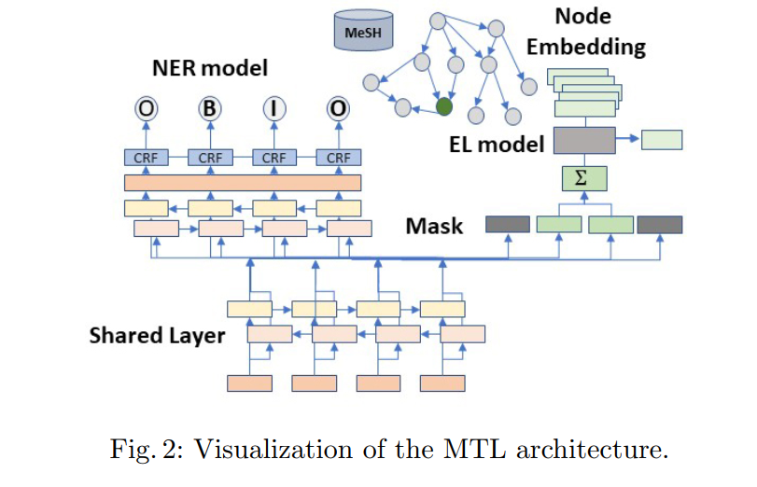
Model

Slide 7
Mention and Concept Embedding
For mention , Bio-ELMo is used to get contextualized embedding.
Average of all tokens of a mention span is taken as a mention embedding.
For Every disease in MESH , we learn a Node Embedding.
This is done in 2 ways:
Node2Vec
Vanilla : Graph structure only
With Lexical info using scope note(BioElmo)
GCN

Slide 8

GCN
GCN is a trainable encoder where node representations are updated in parallel by transforming messages from adjacent nodes in a graph structure.
Stacking L GCN layers allows information to flow from nodes as far as L hops away in graph structure.
For the Oth representation of nodes, we use the bioELMo encoding of a node’s scope note.
Final layer (L) of a node gives the final concept Embedding.

Slide 9
Ranking
Ranking is basically a logistic regression classifier parameterized by a bilinear product between the embedding emb(y) of a node y and the contextualized encoding enc(x;m)
For Node2vec :
p(y|x; m; θ) = exp(enc(x;m)^{T} * W *emb(y))
For GCN
p(y|x; m; θ) = exp(enc(x;m)^{T} * gcn(y; θ))
Where
x : mention , y : disease
gcn(y; θ) = h(y_{L})
Θ -> Trainable params of GCN

Slide 10
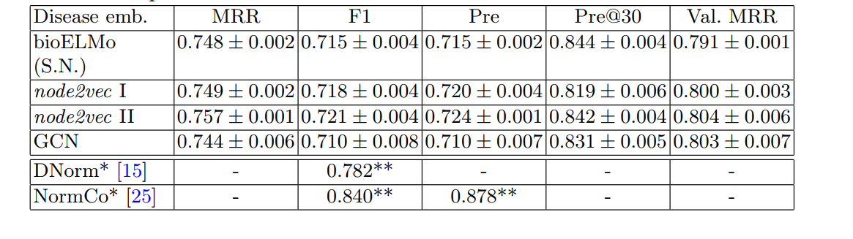
Result- EL

Slide 11
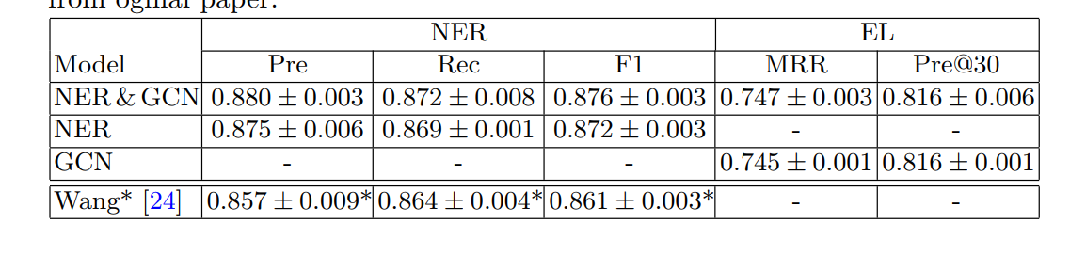
Result - MTL

Slide 12
Error Analysis
A lot of times, linking is done to a node's siblings.
EX : It confuses D016399- Lymphom T-Cell with D015458- Leukemia, T-Cell, with which it shares an ancestor: D008232- Lymphoproliferative Disorders.
This might be due to the fact that MESH and NCBI are not large resources.
Also , we are not looking at disease synonyms , which is leading to degraded results

Slide 13
Expt. Setup for Dual Encoder EL
Dataset : BC5CDR
Unique Mentions : 9,149
Split : 50%-50%-0% ( Train:Test:Dev)
Types : Chemical , Disease
8 Mentions/512 tokens are processed in single forward pass.
128 char as context window , max mention span : 10 tokens
Adam with initial LR : 10⁻⁵ , Model : BioBert_V1.1_pubmed
Ratio of Hard : Random negative candidates – 1:1 (10 of each)
Eval Metric : precision@1 (79.4) and MAP(83.3) after 50 epoch.

Slide 14
Expt Setup for Graph based EL
Dataset : Pubmed Abstracts(792)
Optimizer : Adam , 0.001 LR
Epoch to train Node2Vec : 100 , GCN based EL : 500
All node Emb Dim : 1024
GCN Layers (L) = 2
Metric : Precision@k , Mean Reciprocal Rank

